Slide 1
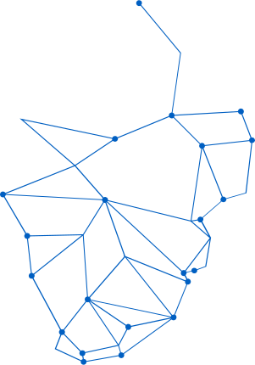

STOCK MARKET PREDICTION USING MACHINE LEARNING
Reliance Stock Analysis (2020–2024) — MCA Project

Slide 2

INTRODUCTION
Stock prices fluctuate daily, influenced by numerous factors including market sentiment, economic indicators, company performance, and global events. This volatility makes the stock market both an opportunity and a challenge for investors.
Accurate stock price prediction is crucial for making informed investment decisions. When investors can anticipate market movements, they can optimize their portfolios, minimize risks, and maximize returns.
However, predicting stock prices remains inherently challenging due to the complex interplay of countless variables. Traditional analysis methods often fall short in capturing these intricate patterns, creating a need for more sophisticated approaches like machine learning.

Slide 3

PROBLEM STATEMENT
Stock prices are highly volatile and unpredictable, influenced by countless factors including market sentiment, economic indicators, and global events. Manual analysis and predictions are time-consuming, prone to human bias, and often inaccurate due to the sheer complexity of financial markets.
Traditional forecasting methods struggle to capture the non-linear patterns in stock data. There is a clear need for automated, data-driven approaches using machine learning models that can analyze large datasets and identify hidden patterns to improve prediction accuracy.

Slide 4
DATASET OVERVIEW
Data Source: Yahoo Finance
Focus: Reliance Industries Limited (RELIANCE.NS), one of India's largest publicly traded companies.
Key Features:
Open Price, High Price, Low Price, Close Price, and Volume Traded — essential metrics for stock price prediction analysis.
Total Records: 992
Daily trading data spanning from 2020 to 2024, providing comprehensive historical coverage for training and testing machine learning models.

Slide 5




TECHNOLOGIES USED
Python Programming Language: The core programming language used for implementing all data processing, analysis, and machine learning algorithms in this stock prediction project.
Data Manipulation Libraries: Pandas for data handling and analysis, NumPy for numerical computations and array operations essential for processing stock market data efficiently.
Visualization & ML Tools: Matplotlib and Seaborn for creating insightful charts and graphs. Scikit-learn for implementing machine learning models including Random Forest and KNN.

Slide 6



DATA PREPROCESSING
No missing values were found in the dataset, ensuring data integrity and eliminating the need for imputation techniques during the preprocessing phase.
Data was scaled using MinMaxScaler to normalize all features between 0 and 1, ensuring consistent scale across variables for optimal model performance.
Dataset was split into training (74%) and testing (26%) sets to enable proper model validation and prevent overfitting during the learning process.

Slide 7



ALGORITHMS USED
Decision Tree Regressor: A simple tree-based model that splits data into branches based on feature values, creating interpretable rules for predicting stock prices.
Random Forest Regressor: An ensemble method combining multiple decision trees to improve prediction accuracy and reduce overfitting through averaging.
K-Nearest Neighbors (KNN): A distance-based algorithm that predicts stock prices by finding the most similar historical data points in the training set.

Slide 8

MODEL TRAINING
Models trained on historical stock price data from Reliance Industries (2020–2024). Each algorithm processes the preprocessed dataset to identify patterns and correlations between features like Open, High, Low prices, and Volume.
Algorithms learn relationships in past data to understand how different factors influence closing prices. The training process iteratively adjusts model parameters to minimize prediction errors and improve accuracy.

Slide 9
MODEL COMPARISON
Decision Tree Regressor
• R² Score: ~0.92
• Easy to interpret results
• Captures complex patterns
• Prone to overfitting
• Variable performance on test data
Random Forest Regressor
• R² Score: ~0.97 (Best)
• Ensemble of decision trees
• Handles non-linear patterns
• Robust against overfitting
• Most stable predictions
K-Nearest Neighbors (KNN)
• R² Score: ~0.85
• Simple distance-based approach
• Fast training time
• Sensitive to feature scaling
• Less accurate for volatile periods

Slide 10

BEST MODEL
Random Forest Regressor emerged as the top-performing model in this study. This ensemble learning method combines multiple decision trees to make predictions, leveraging the collective wisdom of many learners rather than relying on a single model.
Key advantages of Random Forest:
• Aggregates predictions from numerous decision trees for improved accuracy
• Significantly reduces the risk of overfitting compared to single decision trees
• Provides stable and consistent predictions across different data samples
• Handles non-linear relationships in stock price data effectively
The model demonstrated superior performance metrics compared to Decision Tree and KNN algorithms, making it the recommended choice for this stock prediction task.

Slide 11



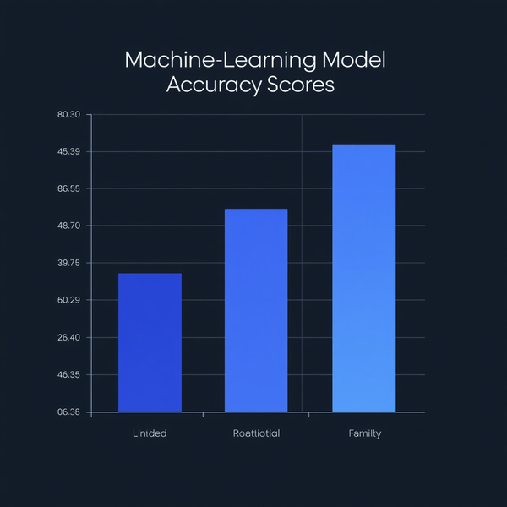
VISUALIZATION
Stock Price Trend Graph: Visual comparison showing actual closing prices versus predicted prices over the testing period, demonstrating how closely the Random Forest model tracks real market movements.
Model Accuracy Comparison: Bar chart displaying R-squared scores for all three algorithms — Random Forest, Decision Tree, and KNN — clearly illustrating performance differences between models.
Key Visual Insights: The trend graph reveals prediction accuracy patterns, while the bar chart provides at-a-glance comparison of model effectiveness for informed algorithm selection.

Slide 12



CONCLUSION
Machine learning models can effectively assist in predicting stock prices by identifying patterns in historical data, providing valuable insights for investment decisions.
Random Forest Regressor emerged as the best-performing model in this study, leveraging multiple decision trees to achieve superior accuracy and stable predictions.
While predictions are useful for guidance, they cannot be perfectly accurate due to inherent market complexity, volatility, and unpredictable external factors.

Slide 13



FUTURE SCOPE
Explore Deep Learning approaches like LSTM (Long Short-Term Memory) networks, which are specifically designed to handle sequential time-series data and can capture long-term dependencies in stock price patterns.
Implement real-time stock price prediction systems that can process live market data, enabling investors to receive instant predictions and make timely trading decisions based on current market conditions.
Incorporate news sentiment analysis to enrich the prediction model with external factors such as financial news, social media trends, and market sentiment, providing a more comprehensive view of market dynamics.

Slide 14
THANK YOU
Questions & Discussion Welcome
MCA Project — Stock Market Prediction Using ML

